Slide 1
Part 1 Gen editable Geometric Representation from Implicit Field Part 2 About BrepGen
BrepGen: A B-rep Generative Diffusion Model with Structured Latent Geometry
Xiang Xu^{1,2}, Joseph G. Lambourne², Pradeep Kumar Jayaraman²,
Zhengqing Wang¹, Karl D.D. Willis², Yasutaka Furukawa¹
¹Simon Fraser University ²Autodesk Research
Part 3 Pruning Filters for Efficient ConvNets
Hao Li¹, Asim Kadav², Igor Durdanovic²,
Hanan Samet^{1,†}, Hans Peter Graf²
¹University of Maryland ²NEC Labs America

Slide 2
Overview
Motivation
Related Works.
Method & Result.
BrepGen.
B-rep format
Structured Latent Geometry
Method & Details
Results & Ablations
Pruning Filters For ConvNet

Slide 3
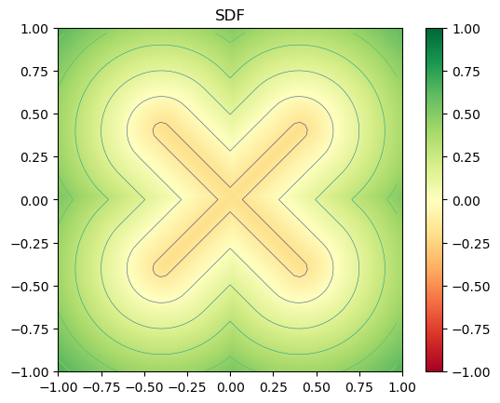
Motivation
Signed distance fields (SDFs) have recently become a powerful tool for modeling shape in 3D generation and surface reconstruction tasks.
There is a gap in how to extract editable and detail-preserving representations from SDFs.
Explicit
Geometric representation

Slide 4
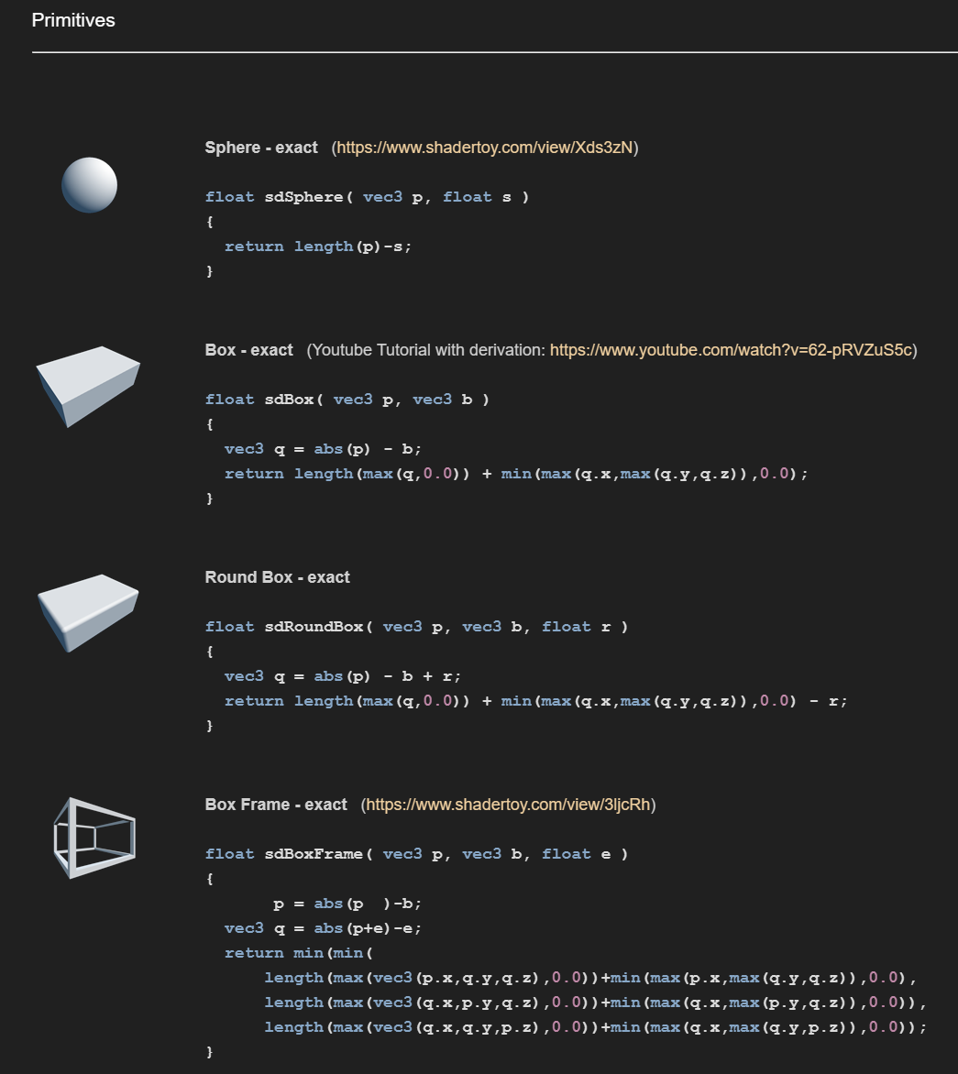
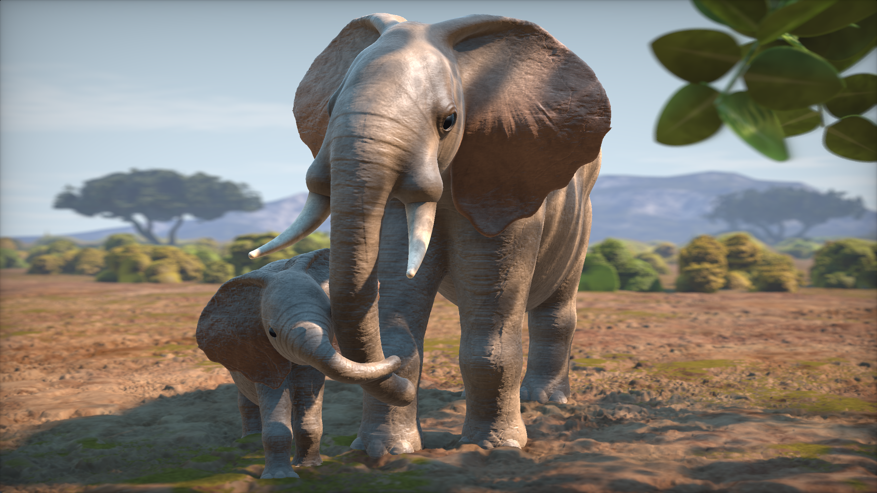

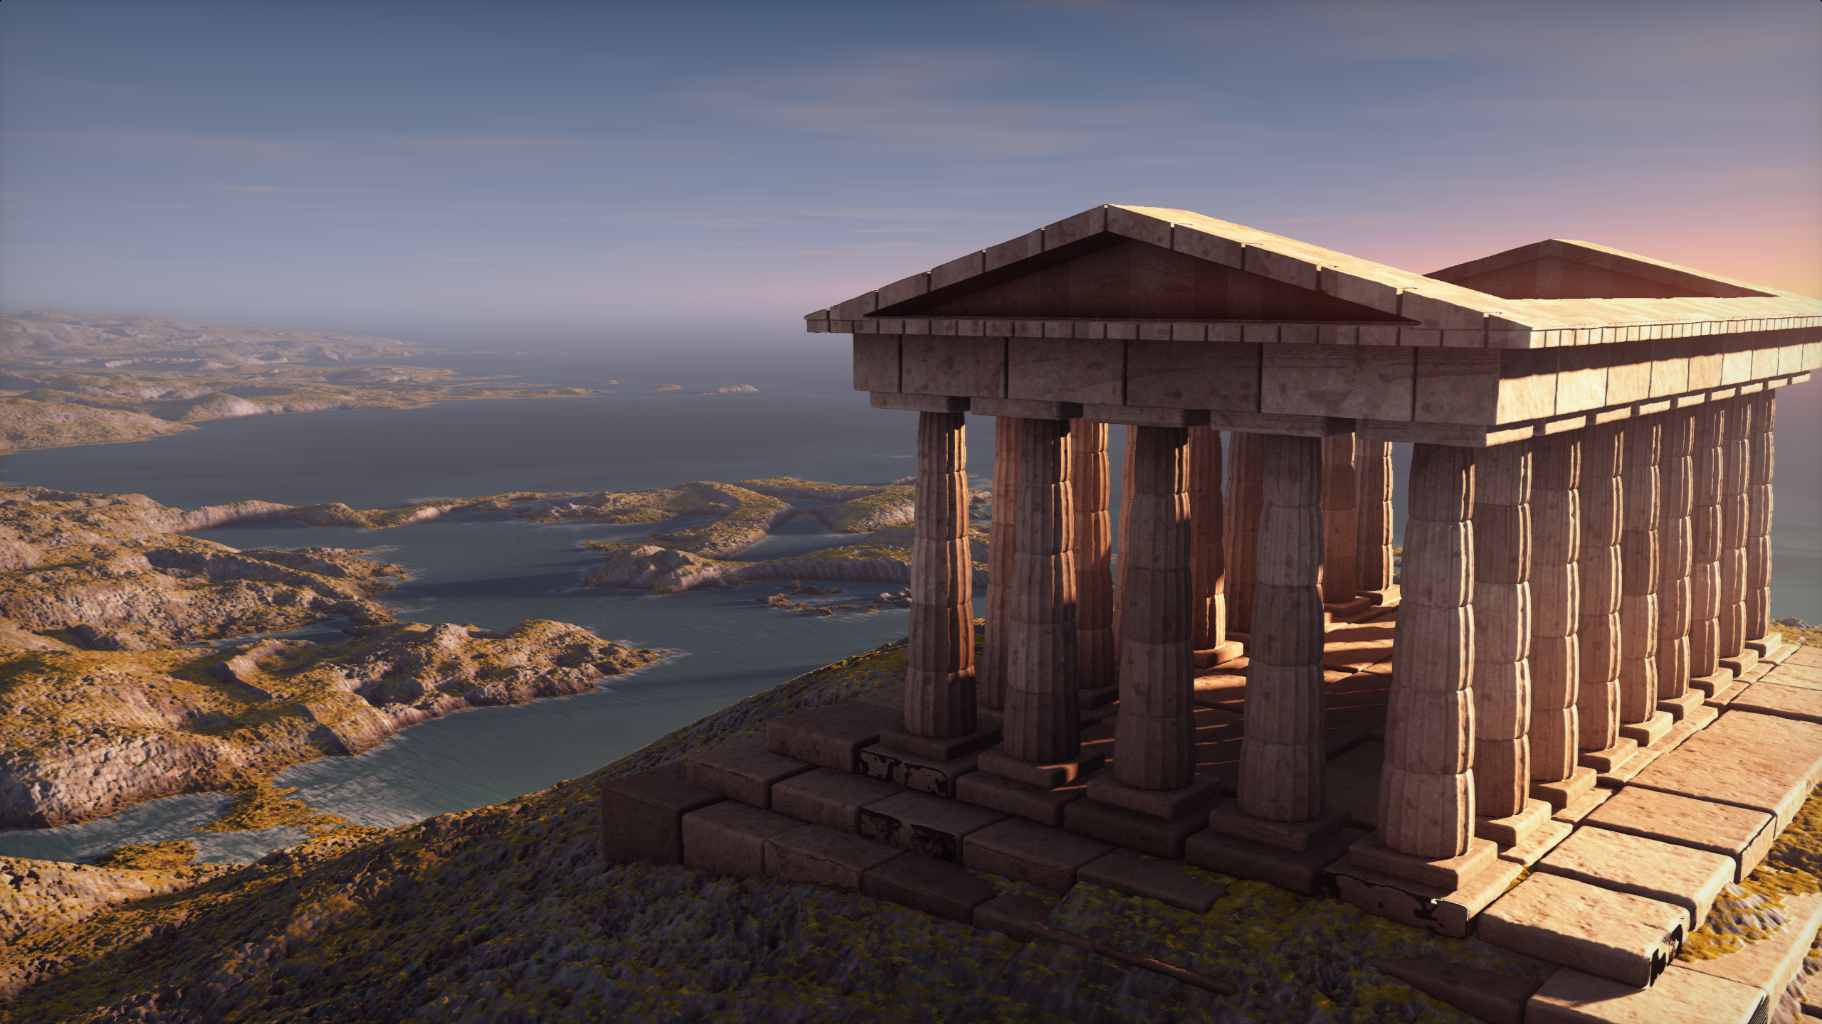
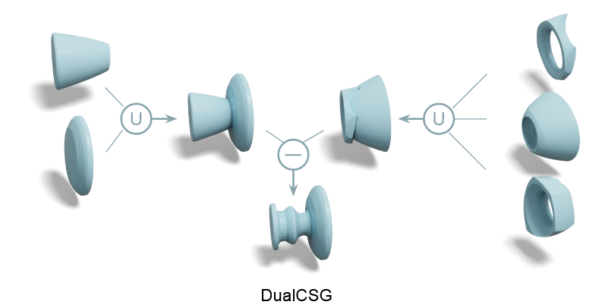
Motivation

Slide 5

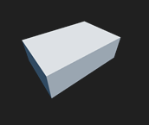





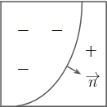
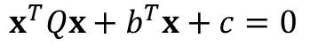
Related Work
About Primitives
Exact SDF Formula
Not Exact SDF Formula
$$x^{T}Qx+b^{T}x+c=0$$

Slide 6
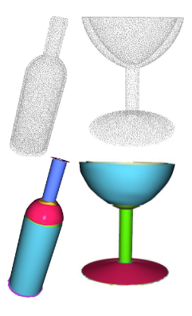
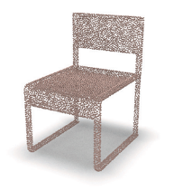
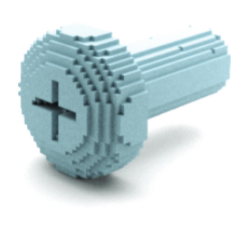
Related Work
About Primitive Prediction
B-Spline
Quadric Equation
Shape
…
Input
Sharma, Gopal, et al. "Parsenet: A parametric surface fitting network for 3d point clouds." Computer Vision–ECCV 2020: 16th European Conference, Glasgow, UK, August 23–28, 2020, Proceedings, Part VII 16. Springer International Publishing, 2020.

Slide 7
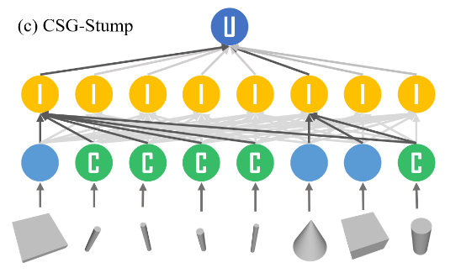
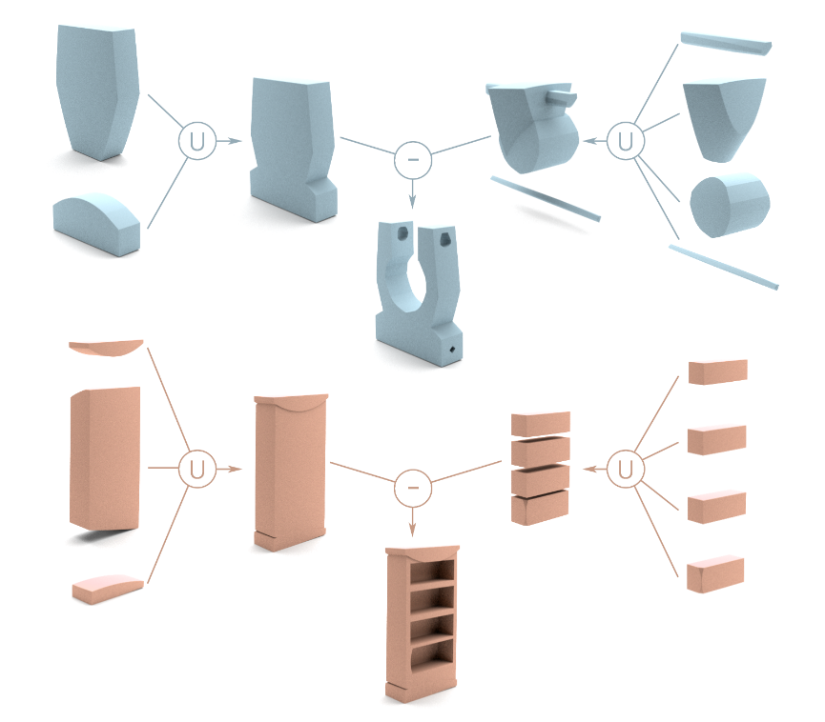
Related Work
About CAD 2 CSG
Input
Encode
Primitive
Prediction
Primitives
Location
Selection
Primitives
CSG
Location
Yu, Fenggen, et al. "Capri-net: Learning compact cad shapes with adaptive primitive assembly." Proceedings of the IEEE/CVF Conference on Computer Vision and Pattern Recognition. 2022.
Ren, Daxuan, et al. "Csg-stump: A learning friendly csg-like representation for interpretable shape parsing." Proceedings of the IEEE/CVF International Conference on Computer Vision. 2021.

Slide 8
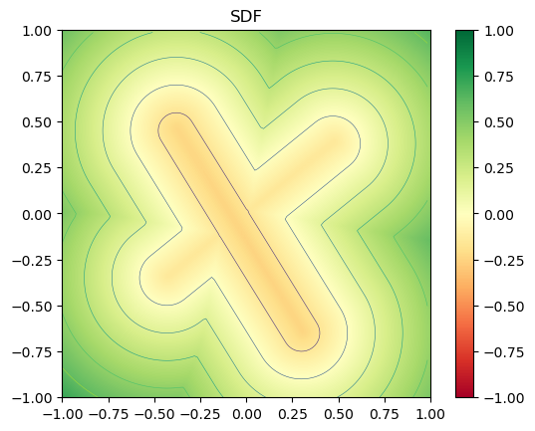
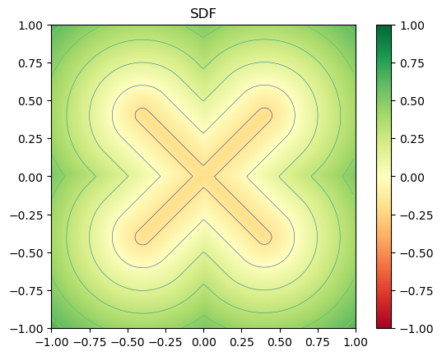
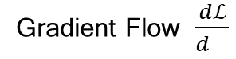

Tries & Issues
Use Capsule fix Capsule
Gradient Flow $\frac{dℒ}{d }$
Primitives
Union
$$ℒ$$
Location
Result

Slide 9
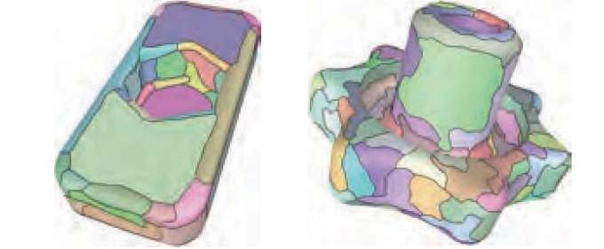
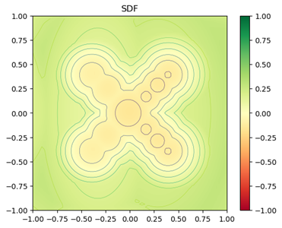

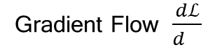

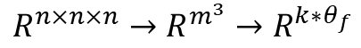
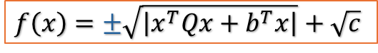

Tries & Issues
Use Quadratic fix Capsule
Gradient Flow $\frac{dℒ}{d }$
Primitives
Union
$$ℒ$$
Location
$$f\left(x\right)=±\sqrt{\left|x^{T}Qx+b^{T}x\right|}+\sqrt{c}$$
Primitives
Flatten Latent
Union
Location
$$R^{n×n×n}→R^{m^{3}}→R^{k∗θ_{f}}$$
$$ℒ$$

Slide 10
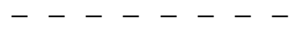
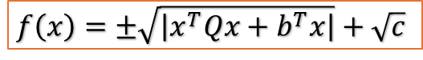
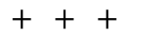
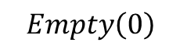

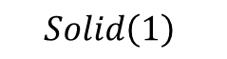

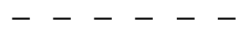
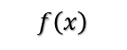
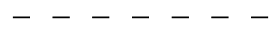
Tries & Issues
Why and How to solve
$$f\left(x\right)=±\sqrt{\left|x^{T}Qx+b^{T}x\right|}+\sqrt{c}$$
Quadratic surfaces and …… do not have exact SDF functions
$$+ + + + + + + + +$$
$$f\left(x\right)$$
$$Empty\left(0\right)$$
$$+ + + + + +$$
$$+ + +$$
$$− − − − − −$$
$$Solid\left(1\right)$$
$$− − − − − − −$$
$$− − − − − − − −$$

Slide 11
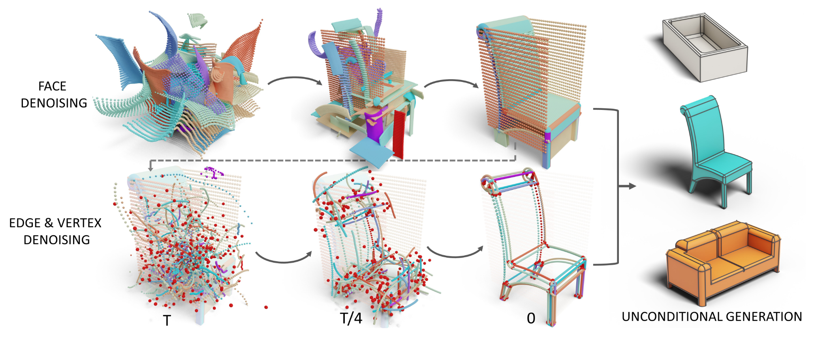
BrepGen A B-rep Generative Diffusion Model with Structured Latent Geometry
CVPR 2024
Xiang Xu^{1,2}, Joseph G. Lambourne², Pradeep Kumar Jayaraman²,
Zhengqing Wang¹, Karl D.D. Willis², Yasutaka Furukawa¹
¹Simon Fraser University ²Autodesk Research
Notes:
A6000

Slide 12
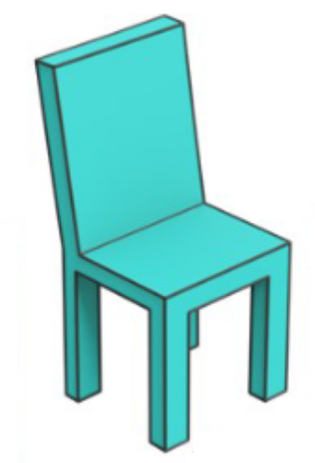
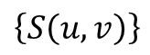
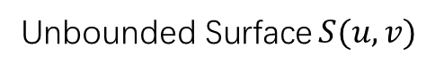

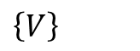
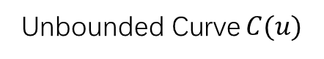
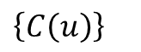
B-rep Format
Face & Edge & Vertex
Unbounded Surface $S(u,v)$
Unbounded Curve $C(u)$
Vertex $V$
$$V∈C(u)∈S(u,v)$$
Chair
…
$$\left\{S\left(u,v\right)\right\}$$
…
$$\left\{C\left(u\right)\right\}$$
…
$$\left\{V\right\}$$

Slide 13
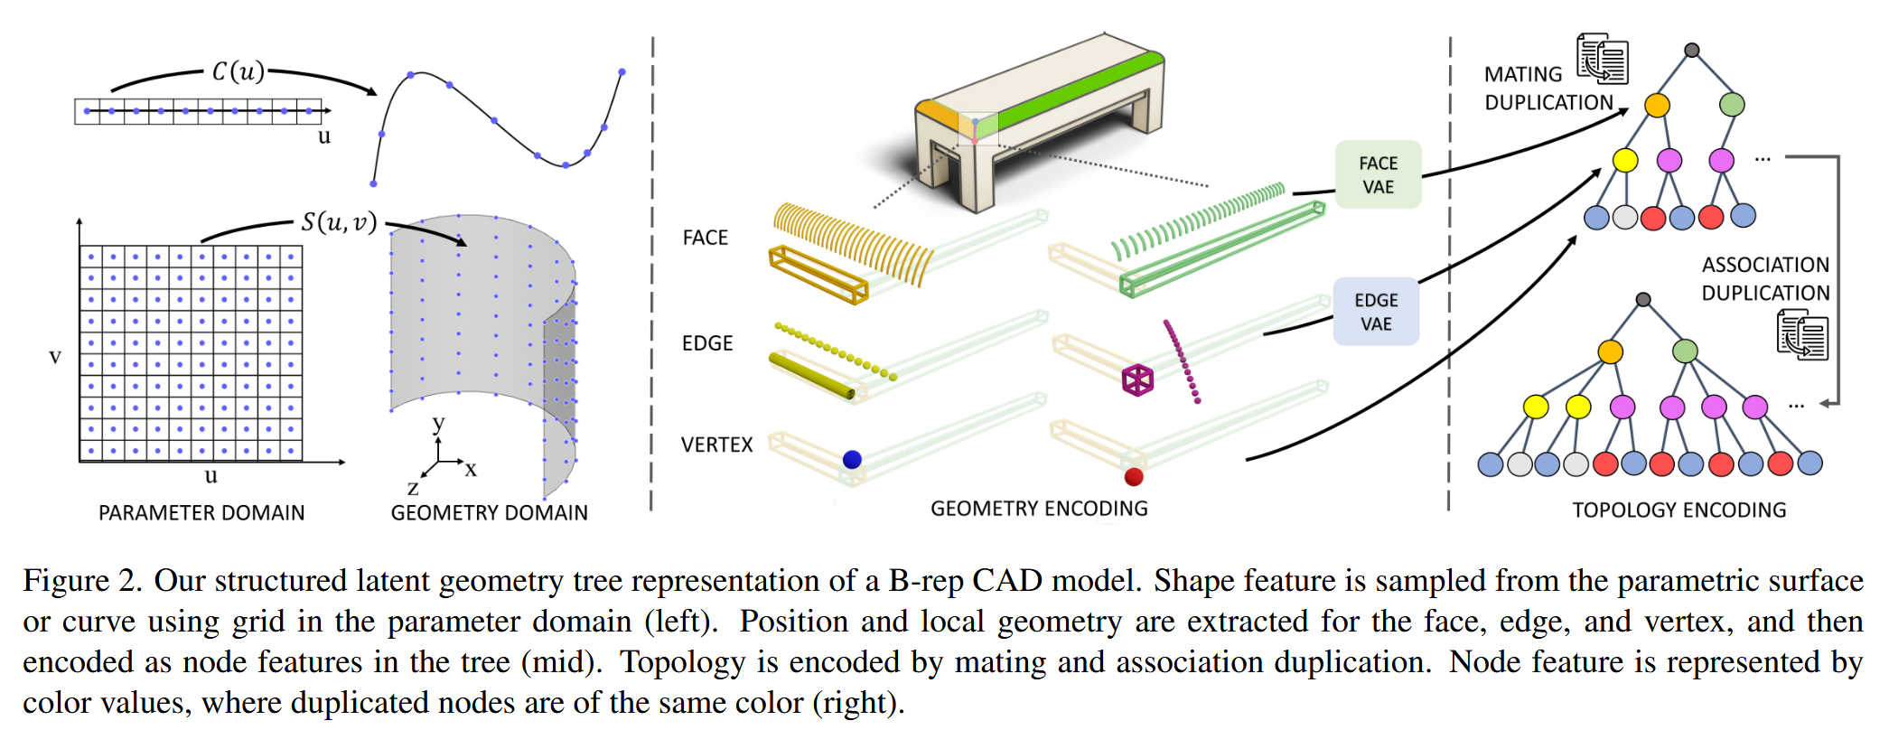
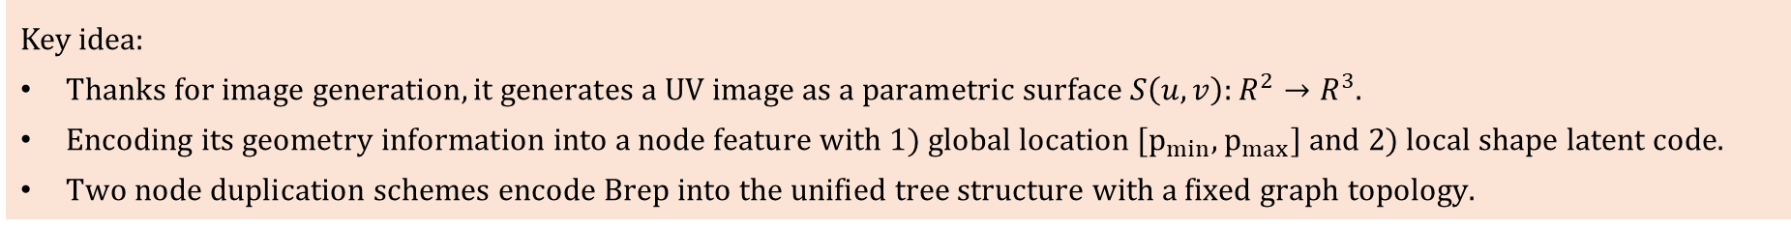
Structured Latent Geometry
Key idea:
$Thanks for image generation, it generates a UV image as a parametric surface S\left(u,v\right):R^{2}→R^{3}.$
$Encoding its geometry information into a node feature with 1) global location [p_{min},p_{max}] and 2) local shape latent code.$
$Two node duplication schemes encode Brep into the unified tree structure with a fixed graph topology.$

Slide 14


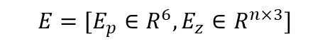
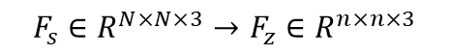
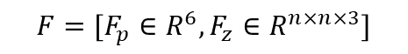

Structured Latent Geometry
$$F_{s}∈R^{N×N×3}→F_{z}∈R^{n×n×3}$$
$$E_{s}∈R^{N×3}→E_{z}∈R^{n×3}$$
Surface
Edge
Vertex
E+V
Flatten
Flatten
$$V=\left(x,y,z\right)$$
$$E=[E_{p},E_{zv}∈R^{n×3+6}]$$
$$F=[F_{p}∈R^{6},F_{z}∈R^{n×n×3}]$$
$$E=[E_{p}∈R^{6},E_{z}∈R^{n×3}]$$

Slide 15
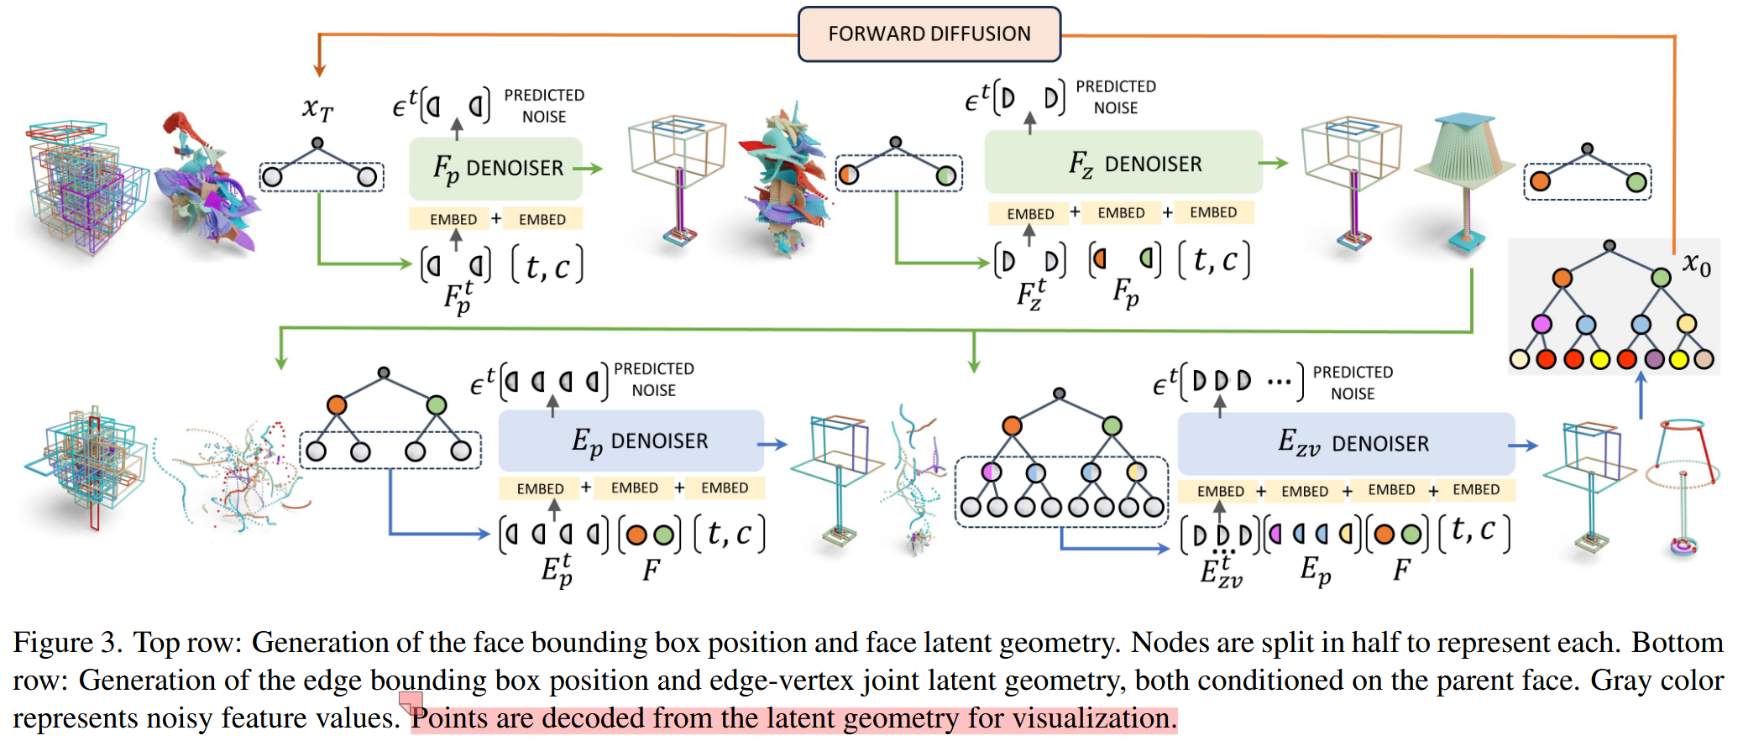
Method & Details
$\text{The} \text{two} \text{VAEs}\text{, }\text{with}\text{ 2}\text{D} \text{conv} \text{UNet} \text{backbone}\text{, }\text{compress} \text{the} \text{shape} \text{feature} F_{s},E_{s}$ into lower-dim latent $F_{z},E_{z}$.
$The Four denoiser share a common Transformer backbone.$
$\text{The} \text{denoiser} \text{is} \text{MLP} \text{which} \text{is} \text{fully} \text{connected} \text{layers} \text{with} \text{SiLU} \text{activation}\text{.}$

Slide 16
Method & Details
$Train VAEs. \left\{F_{s},E_{s}\right\}↔\left\{F_{z},E_{z}\right\}$
$Train the four denoiser. 𝒩\left(0,I\right)→\left\{F_{p},F_{z},E_{p},E_{zv}\right\}$

Slide 17
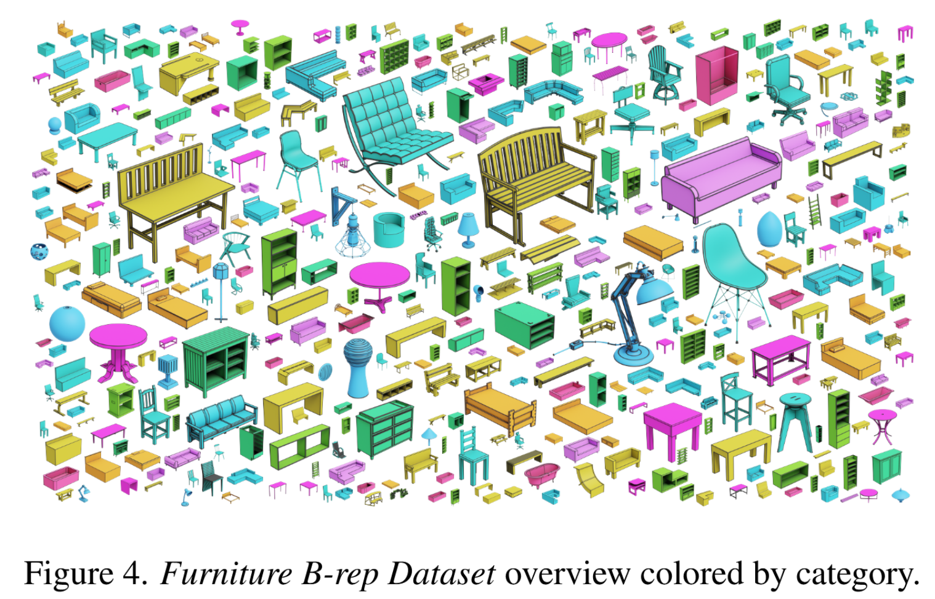
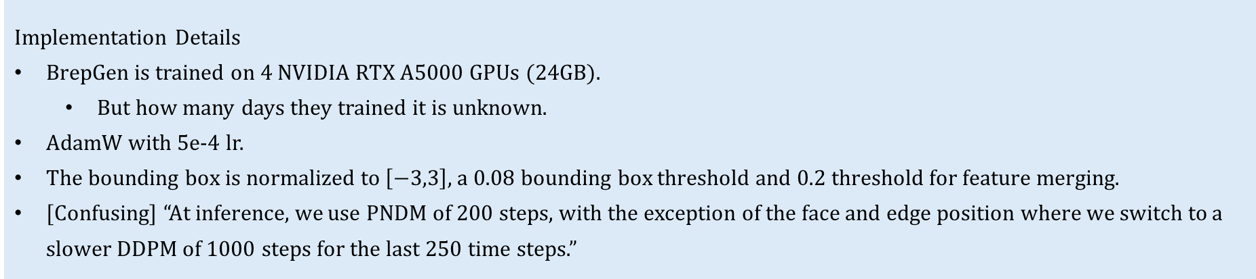
Method & Details
Dataset
Containing 6171 Brep CAD models across 10 common categories.
However, in evperiment, they seem to remove the Breps with more than 30 faces or 20 edges per face, and made from multiple bodies.
Generation is evaluated on the DeepCAD and Furniture B-rep datasets.
Implementation Details
BrepGen is trained on 4 NVIDIA RTX A5000 GPUs (24GB).
But how many days they trained it is unknown.
AdamW with 5e-4 lr.
The bounding box is normalized to $\left[−3,3\right]$, a 0.08 bounding box threshold and 0.2 threshold for feature merging.
[Confusing] “At inference, we use PNDM of 200 steps, with the exception of the face and edge position where we switch to a slower DDPM of 1000 steps for the last 250 time steps.”

Slide 18
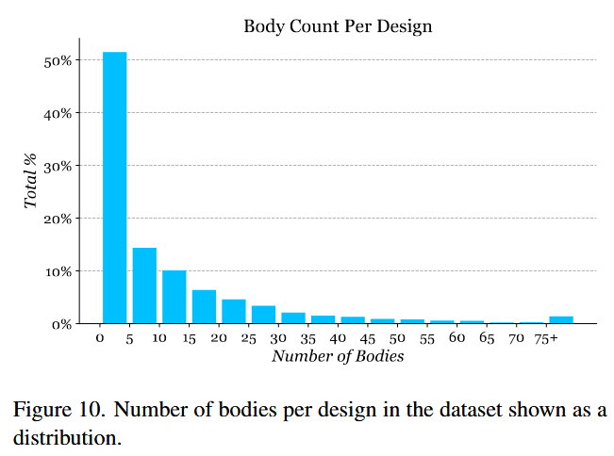
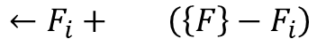
Method & Details
Confusing
How many faces are generated is unknown.
Can Node Duplication schemes ensure that the generated edges order surface domain is closed?
I do not understand what “Number of bodies per design” means.
$$←F_{i}+ \left(\left\{F\right\}−F_{i}\right)$$
?

Slide 19
Pruning Filters for Efficient ConvNets
ICLR 2017
Hao Li¹, Asim Kadav², Igor Durdanovic²,
Hanan Samet^{1,†}, Hans Peter Graf²
¹University of Maryland ²NEC Labs America
Notes:
A6000

